Slide 1

Driving towards zero
Analysing the causes of road fatalities

Slide 2
Agenda
Executive Summary
Context
Data overview
Key contributing factors
Model creation and insights
Next steps

Slide 3

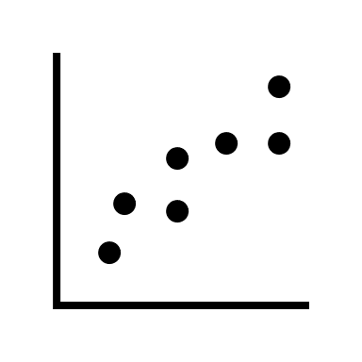


What are we modeling?
Raw Data
Results
Analysis
Crash data 2000 – 2020
ABS rural data
Data cleaning
Summary statistics
Hypothesis testing
Random forest model
What are the factors that make a crash fatal?

Slide 4
Executive Summary and Recommendations
Speed limits, rural level, age and accident type are the features that most strongly predict whether a crash is fatality
Higher speed limits tend to the strongest predictor of fatalities
Being in a metropolitan area greatly decreases the chance of death
Death rates increase with age
Vehicle collisions had a low rate of death
Reducing road deaths requires a different strategy to reducing crashes
A number of datapoints that are correlated with an increase nominal accident amounts (location, peak hour traffic etc.) show a negative correlation with fatality
More work and data is needed to truly get the number to zero
The model is unable to reasonably reduce the number of false positives. This is likely because there are distinguishing features in crashes that the data does not contain (i.e. blood alcohol levels)
Detailed breakdowns of crash fatalities may be useful – similar to airplane backboxes
Need to compare to traffic data to create a better model around frequency and risk rates
Early recommendations are improved resource allocation and education
Focus on infrastructure rural and high-speed roads
Safety and awareness campaigns aimed at motorcyclists/cyclists*
* The difference between motorcyclists and cyclists needs to be investigated further. In the analysis they were grouped.

Slide 5
Agenda
Executive Summary
Context
Data overview
Key contributing factors
Model creation and insights
Next steps

Slide 6
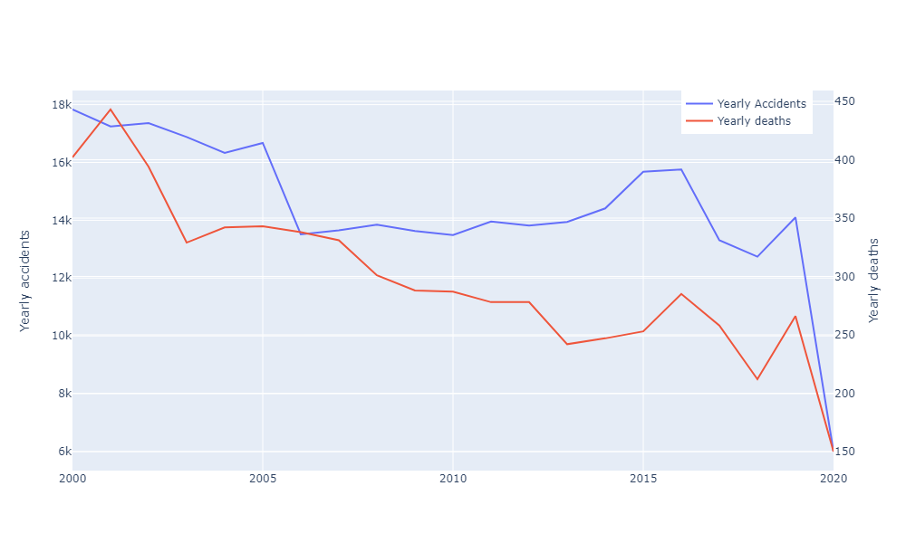
Road deaths and accidents are down Fatalities decreased at a faster rate than accidents (34% and 21% decrease respectively from 2000-19)
Year | Accidents | Deaths
2000 | 17831 | 402
2001 | 17247 | 443
2002 | 17361 | 394
2003 | 16880 | 329
2004 | 16333 | 342
2005 | 16675 | 343
2006 | 13512 | 338
2007 | 13649 | 331
2008 | 13847 | 301
2009 | 13629 | 288
2010 | 13490 | 287
2011 | 13954 | 278
2012 | 13813 | 278
2013 | 13941 | 242
2014 | 14410 | 247
2015 | 15676 | 253
2016 | 15755 | 285
2017 | 13311 | 258
2018 | 12741 | 212
2019 | 14100 | 266
2020 | 5998 | 150
2020 created a unique set of circumstances for data, and was ignored during testing

Slide 7
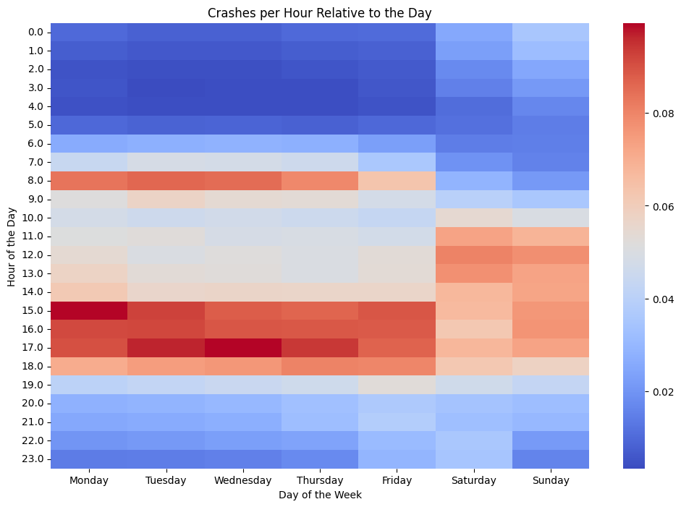
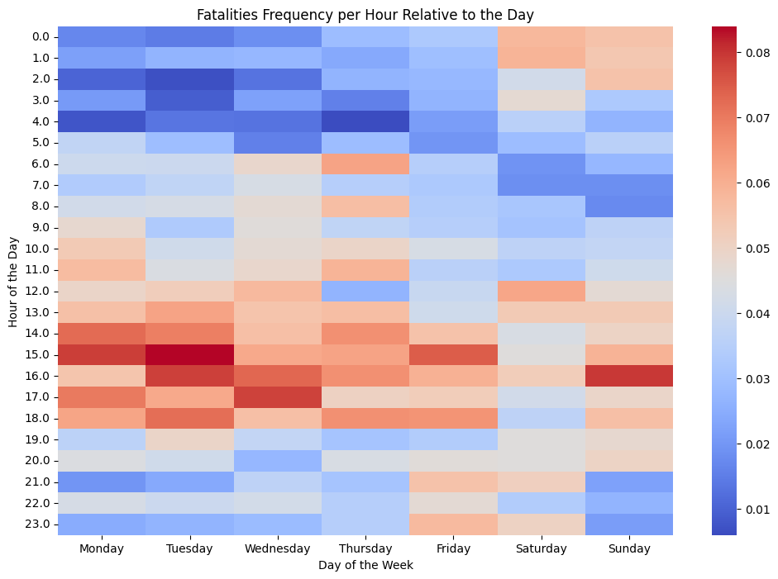
Hours with the highest frequency of crashes – are not the hours with the highest rate of road fatalities
Crash rates peak around peak driving times but...
… fatalities are far more random
While both fatalities and crash frequency are correlated to some extent with traffic, fatalities are far more spread out, and in some cases even buck the trend

Slide 8
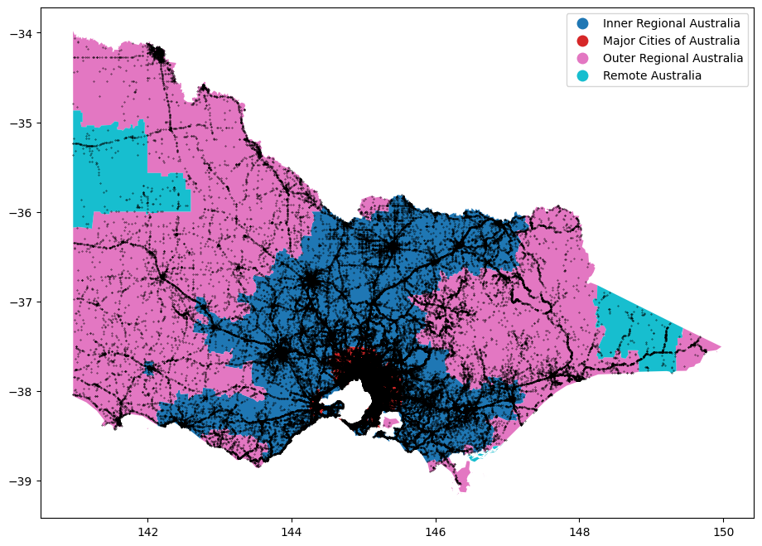
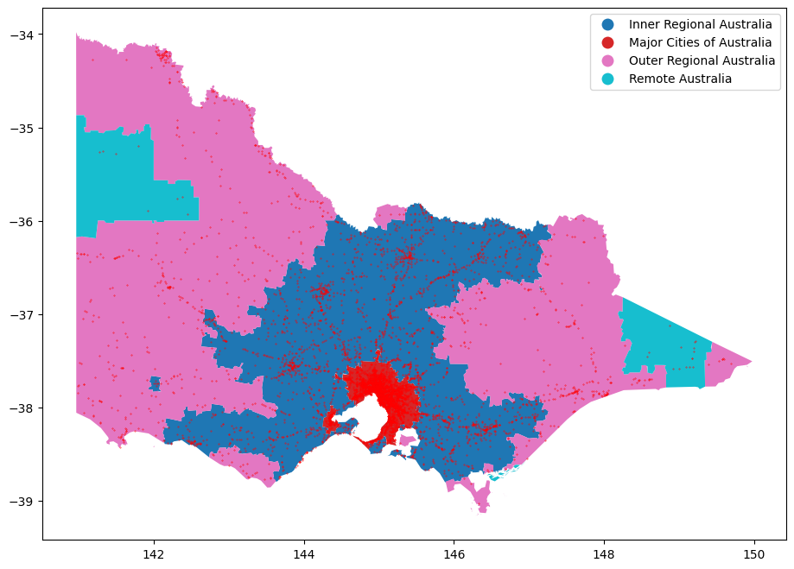
Location of crashes and fatalities are based on population regions.
Map of accidents
Map of fatalities
More work needs to be done to normalise these rates geographically to determine which specific locations are the highest risk.

Slide 9
Agenda
Executive Summary
Context
Data overview
Key contributing factors
Model creation and insights
Next steps

Slide 10
Data is divided into 11 tables
Table | Description | Used?
Accidents | General data on each accident | Yes
Accidents_event | Detailed sequential data of accident | No
Person | General data on all persons involved in the accident | No
Vehicle | General data on all vehicles in the accident | Yes
Node | Data on lat and long of the accident | No
Node_ID | Detailed data on nodes | Yes
Accident_location | Address of accidents | No
Accident_chainage | Location of accident with respect to roads | No
Atmospheric_cond | Weather/atmosphere conditions | Yes
Road_surface_cond | Road surface conditions | Yes
SubDCA | Detailed accident description codes | No
Data quality was largely not an issue except for NODE_ID. The categorization of whether a node was in an urban area or not had duplicates, often with conflicting info. This was substituted using ABS rural indexes
Vehicle data was also rich, but we had to remove a lot of it due to nulls (i.e. weight of vehicle)

Slide 11
Our final set of predictors after performing hypothesis tests and looking at data
Column | Category
"Accident Type Desc", | Accident Info
"NO_OF_VEHICLES", | Accident Info
"NO_PERSONS", | Accident Info
"SPEED_ZONE", | Accident Info
"Road Surface Type Desc", | Accident Info
"Vehicle", | Accident Info
"TOTAL_NO_OCCUPANTS", | Accident Info
"Light Condition Simple", | Accident Info
“NODE_TYPE", | Location info
"Weather", | Location info
"Surface Cond Desc", | Location info
"Rural Level", | Location info
"AGE", | Person info
"SEATING_POSITION", | Person info
"Seatbelt/helmet", | Person info
"Road User", | Person info
"ACCIDENTHOUR", | Time Info
"Day Week Description", | Time Info
"PEAK HOUR", | Time Info
We chose the columns largely based off exploratory data analysis and significance.
We also combined categories as needed to improve interpretability and prevent overfitting.

Slide 12
Agenda
Executive Summary
Context
Data overview
Key contributing factors
Model creation and insights
Next steps

Slide 13
A number of predictors, while having a significant relationship showed a small Cramer V/correlation.
Features | P_value | Cramer_values
Accident Type Desc | 0 | 0.08003
Day Week Description | 2.92E-22 | 0.012073
SPEED_ZONE | 0 | 0.0874
SEX | 5.53E-101 | 0.02524
SEATING_POSITION | 8.57E-07 | 0.007241
Helmet | 0 | 0.085193
Road User | 0 | 0.056868
Road Surface Type Desc | 3.84E-07 | 0.00646
Vehicle | 4.49E-162 | 0.032703
Weather | 7.53E-34 | 0.014705
NODE_TYPE | 0 | 0.044279
RA_NAME21 | 0 | 0.067226
Surface Cond Desc | 2.13E-19 | 0.011149
Light Condition Simple | 0 | 0.064265
MONTH | 0.162258 | 0.002454
PEAK | 4.90E-42 | 0.01594
Only the month fails the significant test, however the correlation of these categories are individually weak

Slide 14
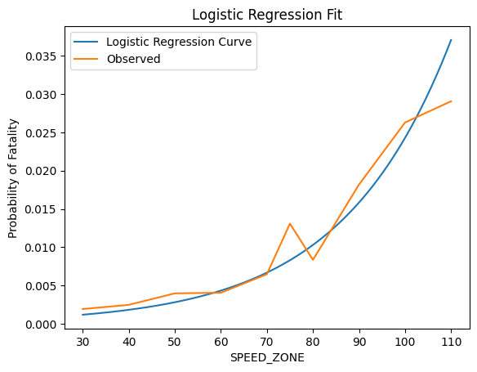
Speed

Slide 15
Region
Source: BCG experts; DEDJTR Project Control Group and Working Group; Arts Agency CEOs and Chairs; Interviews with Thought Leaders October – December 2016

Slide 16
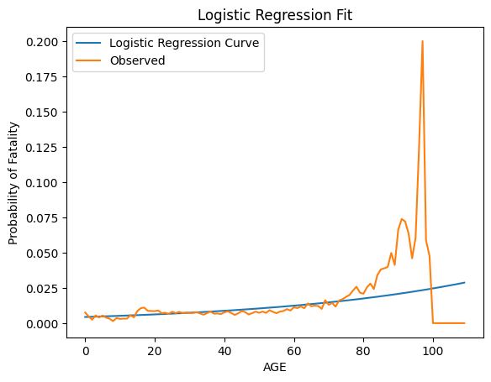
Age

Slide 17
Accident type

Slide 18
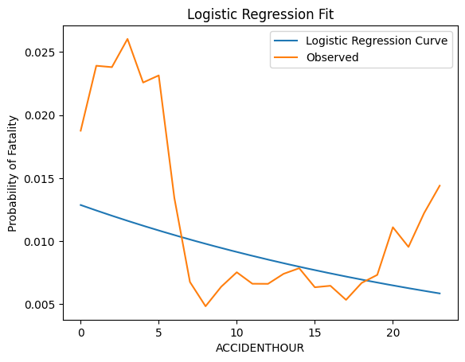
Hours

Slide 19
Agenda
Executive Summary
Context
Data overview
Key contributing factors
Model creation and insights
Next steps

Slide 20
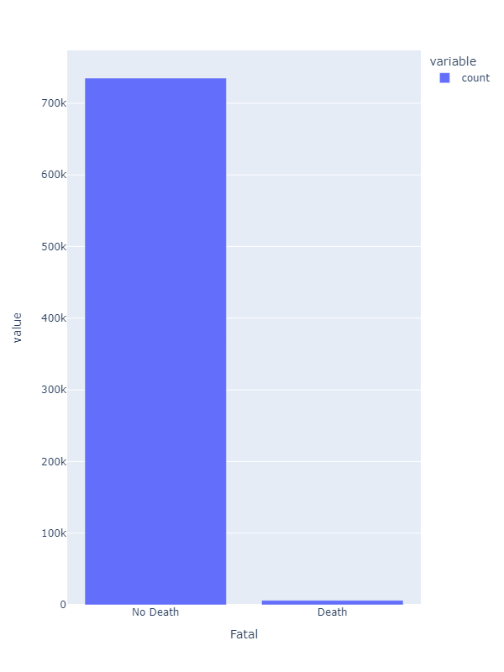
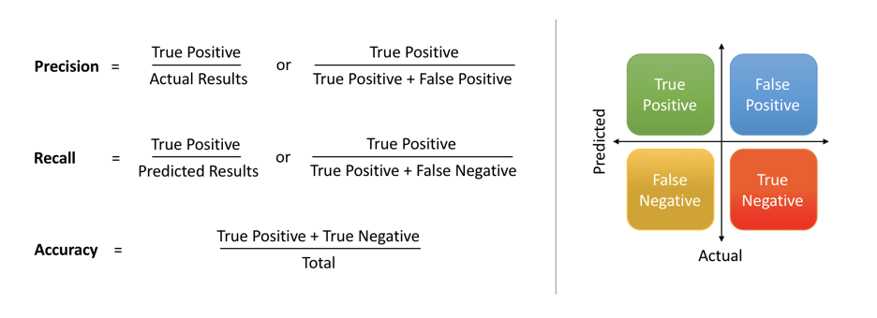
An imbalanced dataset can cause issues Only 0.8% of people involved in a crash will die. We choose to optimize for recall
Models favor the majority class and may perform poorly on the minority class. This can result in a model that always predicts the majority class or does not adequately learn to identify the minority class.
Because we’re primarily interested in what causes a crash, we want to optimize for recall – what are the conditions that can lead to a crash, even if it is still rare.

Slide 21
Choosing the best model
Model | Description | Advantages | Disadvantages
Linear regression | Drawing a line of best fit through data. | Very simple Interpretable | Not suited to binary classification
Logistic regression | Linear regression but returns probabilities (oversimplified) | Interpretable | Doesn’t capture interactions easily Categorical data becomes less interpretable
Random forests | Create a ‘forest’ of decision trees. Classification is decided by majority | Robust to non-linearity Automated feature selection Captures interactions | Less interpretable
Because we see non-linearity and expect some level of complex interactions between variables, we choose random forests

Slide 22
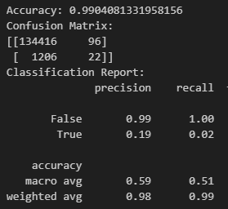
Basic random forest 99% accuracy is trivial

Slide 23
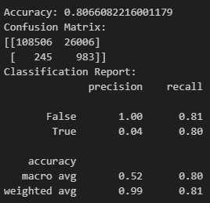
Improving the model
Feature engineering – iterative process already performed
Testing whether we’re overtuned
Hyperparameter tuning – particularly max_depth and min_leaf_samples*
 | Baseline | Basic model | Improved Model
Recall (macro average) | 0.50 | 0.51 | 0.8
*Returned fairly large depth trees and nodes. This implies deep interaction between features

Slide 24
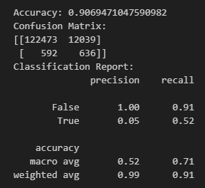
A note on SMOTE Improves precision, at great cost to recall
 | Baseline | Basic model | Improved Model | SMOTE
Recall (macro average) | 0.50 | 0.51 | 0.8 | 0.73
Precision (macro average) | 0.58 | 0.5 | 0.52 | 0.525

Slide 25
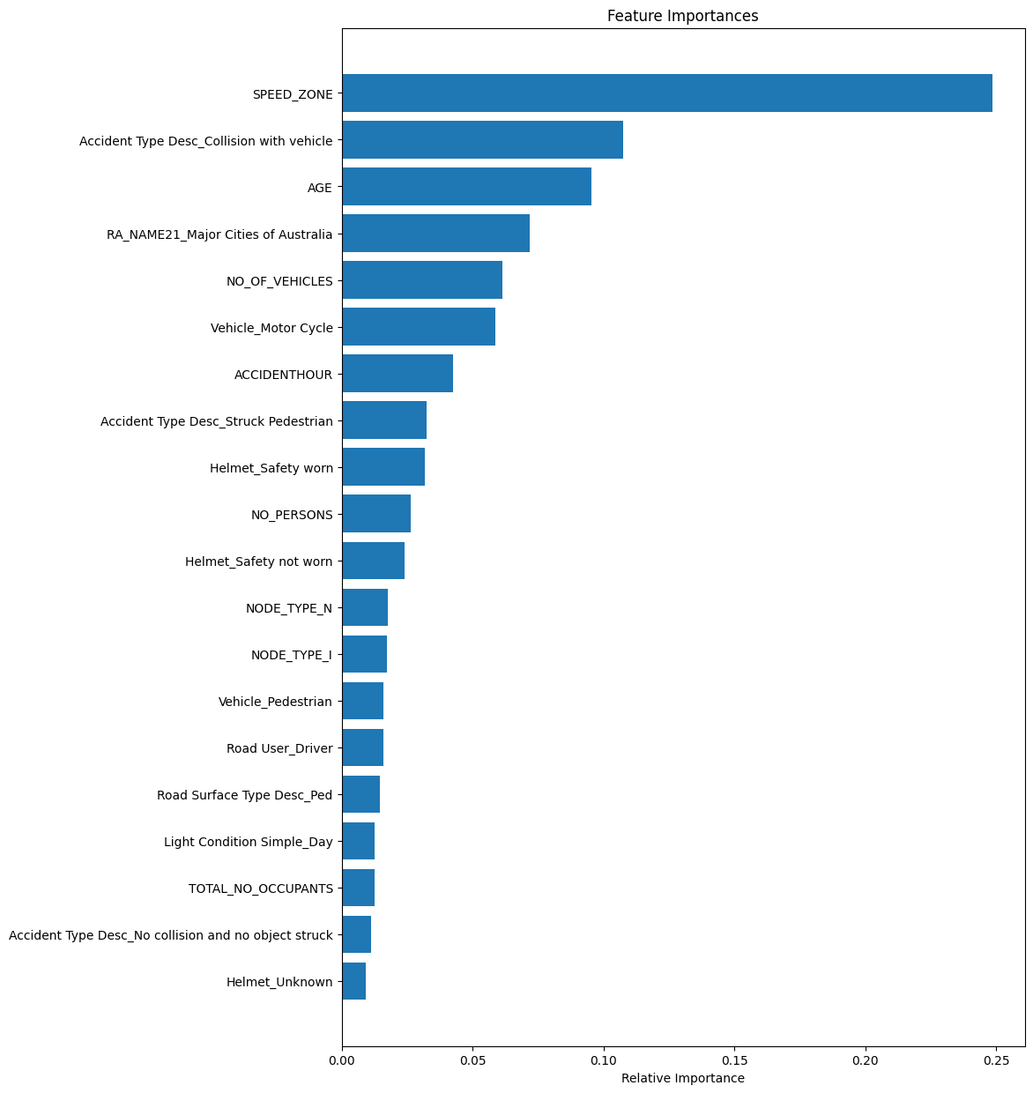
Highest predictors
This chart shows which factors are most important in predicting the outcome of traffic accidents using our model.
Keep in mind that "important" doesn't mean "dangerous." For example, high speed is a key factor that often leads to more severe accidents. But being in a collision with another vehicle, although important for the model, usually results in less severe outcomes.
Also, some factors like rural locations or incidents involving pedestrians are highlighted not because they're especially dangerous, but because they often result in less severe accidents.

Slide 26
Agenda
Executive Summary
Context
Data overview
Key contributing factors
Model creation and insights
Next steps

Slide 27
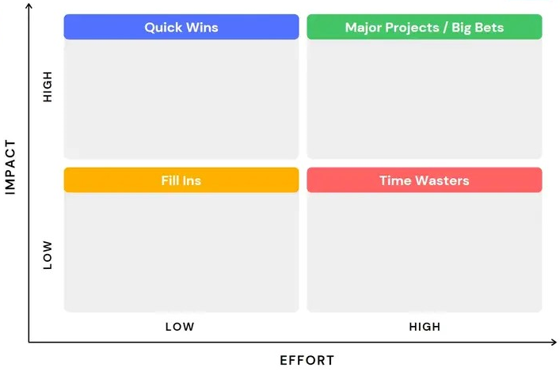
Final reccomendations
Infrastructure investments into non-urban high speed roads
Infrastructure to prevent people veering off road (i.e. road barriers)
Improved emergency response times
Improved datasets to improve analysis
1
1
2
4
2
3
3
4

Slide 28
Areas of improvement
Work with a domain expert to improve feature engineering While we have already performed some feature engineering, most of it was ad-hoc and potentially did not follow best practice.
Identify potential causes of false positives While we optimized for recall, the number of false positives makes the practical use of this model challenging. Identifying new pieces of distinguishing data may help
Process mining The accidents_events table gave some interesting insight into how accidents happened. If we could understand if there are systemic ways fatality occurs, DTP could work to prevent them
Ensemble methods Breaking the model down and looking at pedestrians, car riders, motorcyclists separately can help us understand the different dangers.
Look into the covid-data, unique experiment Covid was excluded as it was largely considered an outlier. However, the reduction in drivers on the roads lead to unique circumstances that might provide important insights

